Slide 1
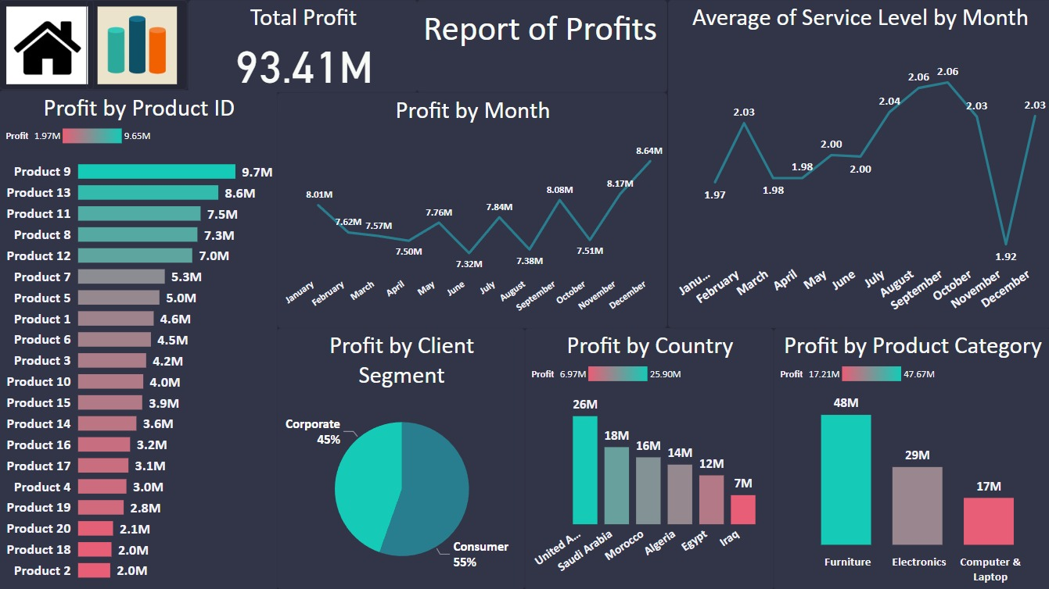
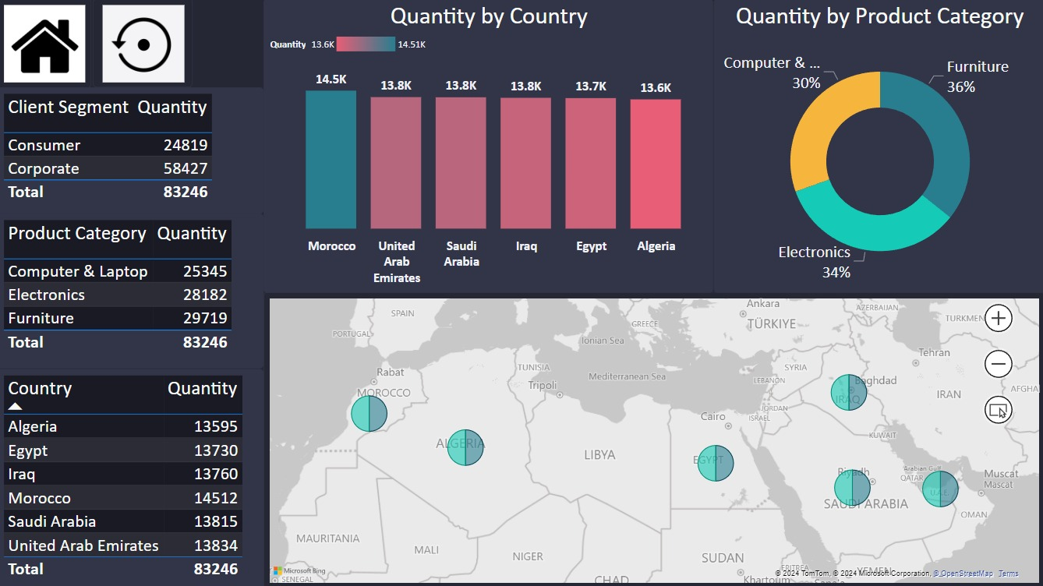
"Unveiling Growth Strategies: Insights from Our Online Store Project"
I am delighted to welcome you to today's presentation on our online store project. As we delve into the data and insights gathered, I am excited to share with you a comprehensive overview of our performance and opportunities for growth. With a total profit of 93.41 million, our journey has been marked by significant achievements and invaluable learnings. Together, we will explore the intricate details of our revenue streams, product categories, geographical markets, and customer segments to unlock new avenues for success. Join me as we navigate through the wealth of information at our disposal and chart a course towards continued prosperity and innovation in the online retail landscape.

Slide 2
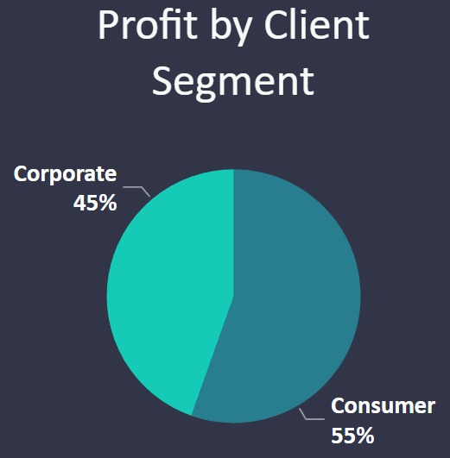
Profit by client segment
In the initial chart depicting "Profit by client segment" the data reveals a breakdown where 55% of the profit is attributed to the Consumer segment, while the Corporate segment accounts for the remaining 45%.
This distribution underscores the significance of the Consumer segment in contributing to overall profitability. Understanding the profit dynamics across different client segments is essential for devising targeted marketing strategies, optimizing resource allocation, and fostering stronger customer relationships.
By leveraging insights from this chart, the organization can tailor its efforts to meet the distinct needs and preferences of each client segment, ultimately driving sustainable growth and profitability for the online store.

Slide 3
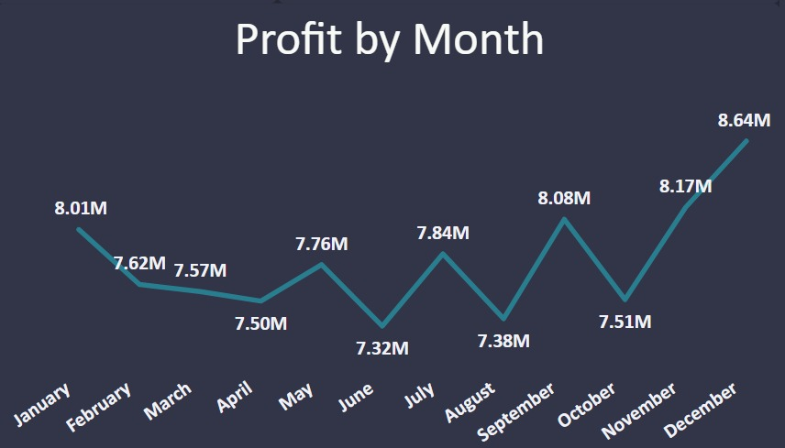
Profit by month
In the "Profit by month" chart, the data showcases the monthly profitability of the online store throughout the year.
It reflects fluctuations in profit, with peaks observed in December at 8.64 million and November at 8.17 million, while the lowest profit is recorded in June at 7.32 million. Understanding these fluctuations is crucial for identifying seasonal trends, optimizing inventory management, and planning marketing campaigns to capitalize on peak months.
By analyzing this chart, stakeholders can gain valuable insights into the financial performance of the online store over the course of the year, enabling informed decision-making to drive profitability and growth.

Slide 4
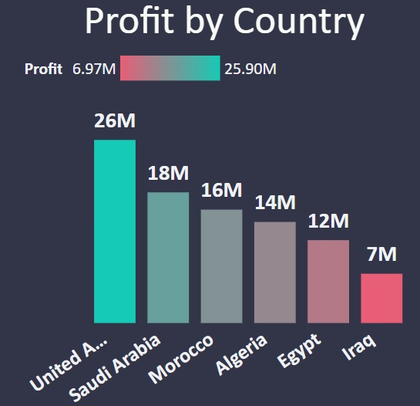
Profit by country
In the "Profit by country" chart, the data delineates the profitability contributions of various countries to the online store, highlighting substantial differences. The United Arab Emirates emerges as the top contributor with 26 million, followed closely by Saudi Arabia at 18 million and Morocco at 16 million.
Egypt and Algeria also demonstrate significant profitability, generating 12 million and 14 million respectively.
Conversely, Iraq exhibits comparatively lower profitability, contributing 7 million.
Understanding these disparities enables strategic decision-making regarding market expansion, resource allocation, and targeted marketing efforts. By leveraging insights from this chart, stakeholders can optimize their approach to maximize profitability across different countries and regions.

Slide 5
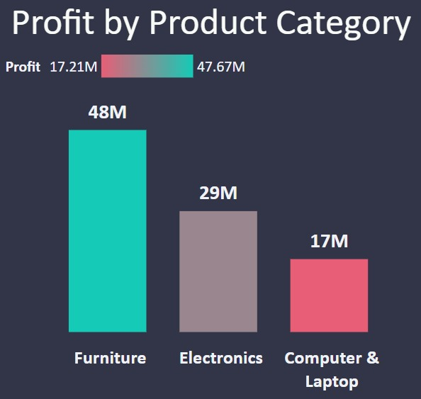
Profit by Category
In the "Profit by Category" chart, the data illustrates the distribution of profits across different product categories within the online store.
Furniture emerges as the top-performing category, generating 48 million in profit, followed by Electronics at 29 million and Computer & Laptop at 17 million.
These insights offer valuable guidance for resource allocation, inventory management, and marketing strategies.
By understanding the profitability of each category, stakeholders can make informed decisions to optimize product offerings, enhance customer satisfaction, and drive overall profitability.
This chart serves as a crucial tool for strategic planning and business growth within the online store.

Slide 6
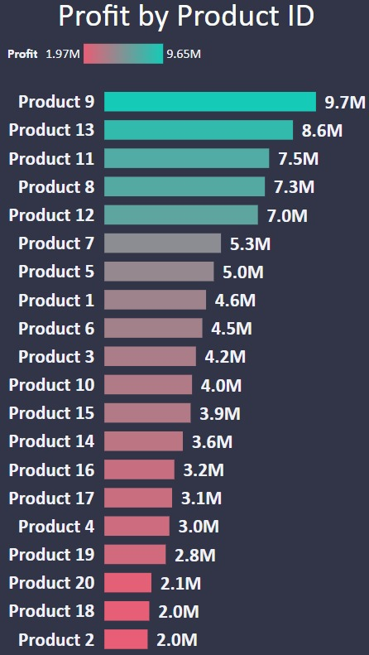
Profit by Product
In the "Profit by Product" chart, the data presents a breakdown of profits generated by different products within the online store.
Product 9 emerges as the top-performing product, generating 9,651,804 million in profit, followed by Product 13 at 8,602,506 million and Product 8 at 7,321,542 million. Conversely, Product 2 exhibits comparatively lower profitability, contributing 1,972,616 million.
These insights provide valuable guidance for inventory management, pricing strategies, and product development initiatives.
By understanding the profitability of each product, stakeholders can make informed decisions to optimize product offerings, enhance customer satisfaction, and drive overall profitability.
This chart serves as a valuable tool for strategic planning and business growth within the online store.

Slide 7
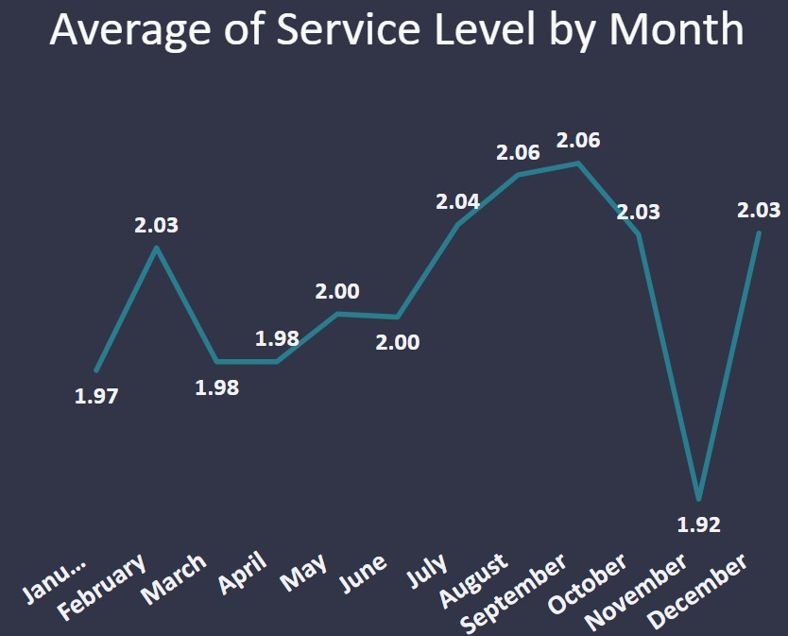
Average service level by month
In the "Average service level by month" chart, the data depicts the average time taken for order fulfillment, measured in days, across different months.
January and March exhibit the shortest average service levels at 1.97 and 1.98 days respectively, while July and August experience slightly longer service levels at 2.04 and 2.06 days.
November stands out with the shortest average service level of 1.92 days, indicating efficient order processing during this period.
These insights provide valuable feedback on operational efficiency and customer service standards, guiding efforts to streamline order fulfillment processes and improve overall service levels throughout the year.

Slide 8
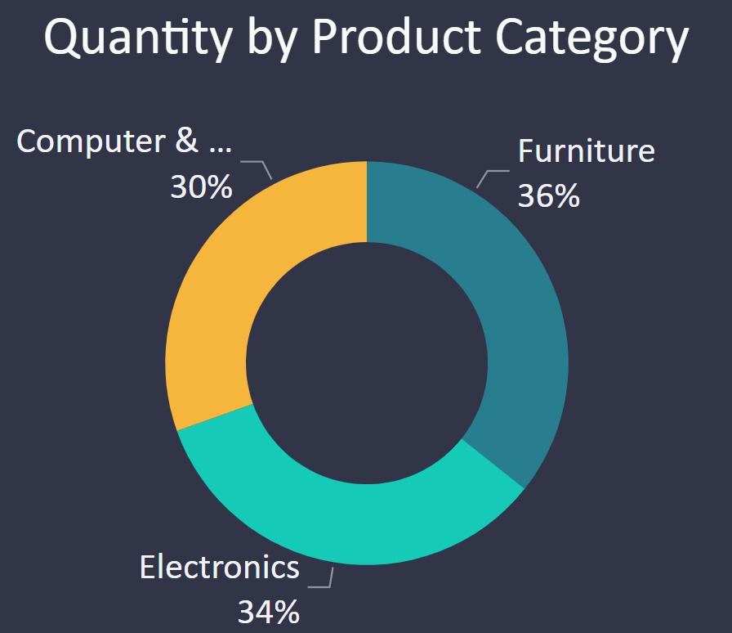
Quantity by Product Category
In the "Quantity by Product Category" chart, the data highlights the proportion of product quantities attributed to different categories within the store.
Notably, Furniture emerges as the most prevalent category, constituting 35.70% of total product quantities.
Electronics closely follows, representing 33.85% of total quantities, while Computer & Laptop products account for 30.45%. These insights provide valuable guidance for inventory management, marketing strategies, and product development initiatives.
By understanding the distribution of quantities across categories, stakeholders can optimize stock levels, tailor marketing campaigns, and cater to customer preferences effectively.
This chart serves as a key resource for informed decision-making and strategic planning within the store.

Slide 9
Final Result
After analyzing the data related to the online store project, several key insights have emerged:
Furniture is the top-performing product category, contributing significantly to both profit and quantity sold.
The United Arab Emirates and Saudi Arabia are the top revenue-generating countries, indicating lucrative markets for expansion efforts.
December stands out as the most profitable month, suggesting the importance of capitalizing on holiday sales and promotions.
Consumer segment accounts for the majority of profits, emphasizing the need for targeted marketing strategies to enhance customer engagement and retention.
Recommendations:
Allocate resources and focus marketing efforts towards the Furniture category, leveraging its strong performance to drive overall profitability.
Implement targeted marketing campaigns in the United Arab Emirates and Saudi Arabia to capitalize on the high revenue potential in these markets.
Plan special promotions and offers during December to maximize sales and profitability during the peak holiday season.
Develop personalized marketing strategies tailored to the Consumer segment to foster stronger customer relationships and loyalty.
By implementing these recommendations, decision-makers can optimize business strategies, drive revenue growth, and enhance overall performance in the online store project.

